Slide 1

Chronic Kidney Disease Prediction
SRM INSTITUTE OF SCIENCE AND TECHNOLOGY
SCHOOL OF COMPUTING
DEPARTMENT OF COMPUTING TECHNOLOGIES
18CSP107L / 18CSP108L - MINOR PROJECT / INTERNSHIP
Batch ID: B140
Student 1 Reg. No:RA2011003010661
Student 1 Name:Palak Rani
Student 2 Reg. No:RA2011003010666
Student 2 Name:Palak Patel
Guide name: Dr. S Babu
Designation: Associate Professor Department: Department of Computing Technologies

Slide 2
Chronic Kidney Disease Prediction
Abstract
Kidney disease, a prevalent and life-threatening medical condition, has become a growing concern worldwide. Timely detection and intervention can significantly improve patient outcomes.
The proposed model utilizes a dataset of clinical and demographic features, including age, gender, blood pressure, serum creatinine, and other relevant parameters, to predict the risk of kidney disease.
Several machine learning algorithms, such as logistic regression, decision trees, random forests, and deep neural networks, are employed to create predictive models.
Feature selection and engineering techniques are applied to enhance the model's accuracy and interpretability.

Slide 3
Abstract
The results demonstrate the model's ability to provide accurate predictions of kidney disease, thus aiding in early diagnosis and intervention.
This predictive modeling approach offers a promising tool for healthcare professionals to identify individuals at risk of kidney disease, enabling timely medical intervention and potentially improving patient outcomes.
This research contributes to the ongoing efforts to enhance healthcare and promote early detection of kidney disease, ultimately reducing the burden on healthcare systems and improving the quality of patient care.

Slide 4
Introduction
Kidney disease is a widespread, yet often undetected, health threat with serious implications for healthcare systems worldwide. Untreated or undiagnosed kidney disease can lead to life-altering consequences, including fatality, making early detection crucial.
It encompasses a spectrum of conditions, from chronic kidney disease (CKD) to acute kidney injury (AKI), which often progress silently and reveal their severity late in the course of the disease.
Advances in medical technology and the integration of data-driven approaches are transforming the way kidney disease is managed.
Predictive models for kidney disease are becoming increasingly important, harnessing the potential of machine learning, data analytics, and vast healthcare data sources.

Slide 5
Introduction
These models aim to identify individuals at risk of kidney disease, enabling early diagnosis and timely medical intervention.
The development of predictive models is pivotal in the contemporary healthcare landscape, where data-driven approaches can improve patient outcomes and reduce the burden on healthcare systems.

Slide 6
Motivation
Kidney disease silently progresses, often without symptoms, making early detection vital to slow or stop its advancement in millions worldwide.
Timely detection and intervention lead to better patient outcomes. Early treatment can slow chronic kidney disease (CKD) progression, lowering the risk of kidney failure and the need for dialysis or transplantation.
Advancements in medical technology and data science motivate kidney disease detection. Researchers explore innovative methods, including machine learning, predictive modeling, and medical imaging, to improve accuracy and efficiency in detection.
Early detection and management of kidney disease can save healthcare costs by reducing the need for costly treatments and hospitalizations associated with advanced stages.
Kidney disease can significantly impact a person's quality of life. Early detection and effective management can improve their quality of life, promoting independence and activity.

Slide 7
Literature Review
S.No. | Author | Description | Finding
1. | Robert Nee, Christina M Yuan, Andrew S Narva, Guofen Yan, Keith C Norris-Overcoming barriers to implementing new guideline-directed therapies for chronic kidney disease-20 October 2022 | Guideline-recommended therapies for CKD and diabetes offer significant benefits, but their adoption is hindered by various barriers, including clinical inertia, lack of awareness, and high drug costs. Overcoming these challenges requires a multifaceted approach using the Chronic Care Model to improve education, engagement, and healthcare systems. | A comprehensive strategy, employing the Chronic Kidney Disease (CKD) care model and ensuring equitable access to high-quality care, can help alleviate obstacles to achieving the best possible CKD treatment.
2. | Pankaj Chittora , Sandeep Chaurasia1 , Prasun Chakrabarti, Gaurav Kumawat1 , Tulika Chakrabarti , Zbigniew Leonowicz, Michał Jasiński, Łukasz Jasiński, Radomir Gono, Elżbieta Jasińska, and Vadim Bolshev-Prediction of Chronic Kidney Disease - A Machine Learning Perspective-22 January 2021 | This article discusses the significance of early diagnosis of Chronic Kidney Disease (CKD) and the application of machine learning techniques for CKD prediction. The study utilizes a dataset from the UCI repository and tests seven classifier algorithms, including artificial neural networks, C5.0, Chi-square Automatic Interaction Detector, logistic regression, linear support vector machines with penalties L1 and L2, and random trees. Feature selection techniques are also employed. | The authors found that the Linear Support Vector Machine (LSVM) achieved the highest accuracy of 98.86% in combination with the Synthetic Minority Over-sampling Technique (SMOTE) and full features. SMOTE was identified as an effective technique for balancing the dataset, particularly when combined with features selected by LASSO regression, outperforming other classifiers and methods.
3. | Jamie P. Dwyer, Abiy Agirob, Pooja Desai, and Henry Cremisi.-Short-term costs in patients with chronic kidney disease treated with dapagliflozin: a retrospective cohort study-Accepted 12 Jul 2023, Published online: 04 Aug 2023 | This real-world study evaluated the impact of dapagliflozin on short-term medical costs in patients with stage 3 chronic kidney disease (CKD).Methods: This study used medical and pharmacy claims data from IQVIA PharMetrics Plus. Patients aged ≥18 years with a filled dapagliflozin prescription after stage 3 CKD diagnosis between September 2020 and December 2021. | This study showed dapagliflozin was associated with reduced cardiorenal medical costs over 6 months compared with no dapagliflozin treatment in patients with stage 3 CKD, demonstrating real-world medical cost savings.

Slide 8
Literature Review
4. | O. Aruna; Sk Sameerunnisa.-Chronic Kidney Disease Prediction using Data Pre-Processing Techniques- 2023 5th International Conference on Smart Systems and Inventive Technology (ICSSIT) | Machine learning is employed for predicting both the positive status and phases of Chronic Kidney Disease, and having a high-quality training dataset is crucial for building effective predictive models. Algorithms extract relevant features from this data and uncover significant relationships. The UCI repository dataset is widely recognized as a benchmark in this field due to its extensive use in similar research. This dataset contains 400 examples with 25 properties, although it may have redundant or incomplete characteristics. Handling missing values depends on how predictably they were lost in the clinical data analysis. | The paper discusses the importance of accurately predicting the onset of chronic kidney disease, a widespread and potentially fatal condition affecting a significant portion of the global population. Achieving a 100% accuracy rate in early diagnosis is crucial for cost-effective and risk-reducing interventions. The authors propose an efficient prediction algorithm through careful feature engineering and emphasize the use of statistical approaches like mean and median for estimating missing values, improving prediction accuracy.

Slide 9
Challenges of Existing System
Data Quality: Inaccurate or incomplete medical data can hinder the performance of predictive models, leading to suboptimal results.
Interpretability: Complex machine learning models can lack transparency, making it challenging for healthcare professionals to understand and trust the predictions.
Data Privacy: Handling sensitive patient data raises concerns about privacy and data security, which may limit data availability for research.
Imbalanced Data: In many cases, the data may be imbalanced, with a disproportionate number of healthy patients compared to those with kidney disease, affecting model accuracy.
Early Detection: Predicting kidney disease in its earliest stages remains a challenge, as symptoms may not yet manifest.
Generalization: Models may struggle to generalize across different populations or healthcare settings, limiting their broader applicability.

Slide 10
Challenges of Existing System
Risk Factors: Identifying and incorporating all relevant risk factors into predictive models can be complex, as new risk factors are continually being discovered.
Risk Factors: Identifying and incorporating all relevant risk factors into predictive models can be complex, as new risk factors are continually being discovered.
False Positives and Negatives: Models may produce false positives or negatives, leading to unnecessary interventions or missed diagnoses.

Slide 11
Problem statement and Objectives
Problem statement
Kidney diseases are major causes of global morbidity and mortality.
These diseases impose a significant burden on healthcare systems and patients.
Early detection and prediction are essential for improved patient outcomes.
Traditional diagnostic methods have limitations.
Accurate data-driven predictive models are needed.
These models can assist healthcare professionals in identifying high-risk individuals.
The challenge is to develop reliable and interpretable predictive models.
The models should seamlessly integrate into clinical practice.

Slide 12
Problem statement and Objectives
Objectives
Early Detection: The primary objective is to develop a predictive model that can accurately and efficiently identify individuals at risk of developing kidney disease, allowing for early intervention and treatment.
Accuracy: Achieve a high level of accuracy in predicting kidney disease, ensuring that the model minimizes false positives and false negatives to avoid unnecessary anxiety or missed diagnoses.
Interpretability: Design the model to be interpretable, enabling healthcare professionals to understand the factors contributing to the prediction and make informed decisions regarding patient care.
Generalizability: Ensure that the predictive model is applicable across diverse patient populations and healthcare settings, making it valuable for a wide range of clinical scenarios.

Slide 13
Problem statement and Objectives
Objectives
Data Privacy: Implement data privacy and security measures to protect sensitive patient information and adhere to ethical standards and regulations, such as HIPAA compliance.
User-Friendly Interface: Develop a user-friendly interface or application that healthcare providers can easily use to input patient data and access predictions, promoting the seamless integration of the model into clinical workflows.
Clinical Adoption: Promote the adoption of the model within healthcare systems and encourage healthcare providers to utilize it for risk assessment and patient management.
Cost-Effectiveness: Assess the cost-effectiveness of the predictive model in terms of early disease detection, reduced healthcare expenses, and improved patient outcomes.

Slide 14
Problem statement and Objectives
Objectives
Public Health Impact: Aim to reduce the overall burden of kidney disease by enabling proactive healthcare interventions and preventing disease progression.
Validation: Independently validate the model's performance on new datasets to ensure its reliability and generalizability.

Slide 15
Innovation
Early Intervention: The real-time monitoring of patient data allows for early intervention in case of critical changes, ensuring that healthcare providers can act promptly to prevent disease complications.
Improved Patient Engagement: Patients are more engaged in their care, as they have access to real-time data and can easily communicate with their healthcare providers through telehealth services.
Reduced Healthcare Costs: By preventing disease progression and complications, this approach can potentially reduce the overall cost of healthcare associated with kidney disease management.
Data-Driven Personalized Care: The integration of the predictive model ensures that care is highly personalized, taking into account the patient's unique risk factors and disease status.
Scalability and Accessibility: This approach can be scaled to serve a larger population and is accessible to patients regardless of their geographic location, improving healthcare equity.

Slide 16
Scope and Application
Early Detection and Diagnosis: Identifying individuals at risk of kidney disease before symptoms manifest allows for early diagnosis and intervention, potentially slowing down disease progression.
Risk Assessment: Predictive models can stratify individuals based on their risk of developing kidney disease, helping healthcare providers prioritize high-risk patients for more frequent monitoring and intervention.
Chronic Kidney Disease (CKD) Management: Predictive models can be used to monitor the progression of CKD and assess the risk of complications, guiding treatment decisions and lifestyle modifications
Public Health and Epidemiology: Predictive models can provide insights into the prevalence and distribution of kidney disease in specific populations, helping public health agencies allocate resources and plan interventions.
Clinical Decision Support: Healthcare providers can use predictive models as decision support tools to aid in the diagnosis and treatment of kidney disease, especially when faced with complex patient histories.

Slide 17
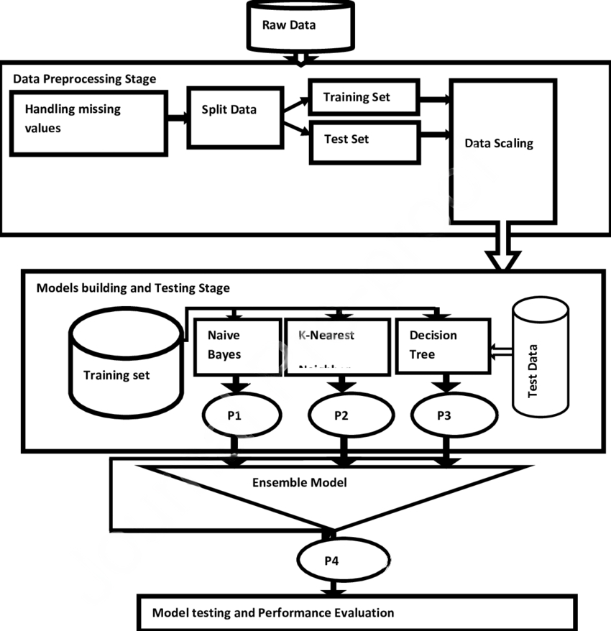
Architecture Diagram
For Kidney Disease Prediction:

Slide 18
Proposed System
Random Forest
Random Forest is a popular ensemble machine learning algorithm used for both classification and regression tasks. It is a powerful and versatile model that combines multiple decision trees to improve predictive accuracy and reduce the risk of overfitting.
Decision Trees:Random Forest is an ensemble learning method that uses decision trees as its base models. Decision trees are simple models that make binary decisions based on input features.
Robustness Against Overfitting:Random Forest is less prone to overfitting compared to individual decision trees because it combines the predictions of multiple trees, reducing the variance and improving generalization.
Feature Importance:Random Forest provides a measure of feature importance. It calculates the impact of each feature on the model's performance, allowing you to identify the most influential variables in the prediction.

Slide 19
Proposed System
Random Forest
Parallelization:Random Forest can be easily parallelized, making it suitable for handling large datasets and benefiting from multi-core processors.
Robustness Against Overfitting:Random Forest is less prone to overfitting compared to individual decision trees because it combines the predictions of multiple trees, reducing the variance and improving generalization.
Feature Importance:Random Forest provides a measure of feature importance. It calculates the impact of each feature on the model's performance, allowing you to identify the most influential variables in the prediction.
Parallelization:Random Forest can be easily parallelized, making it suitable for handling large datasets and benefiting from multi-core processors.

Slide 20
Proposed System
XGBoost
XGBoost (Extreme Gradient Boosting) is a powerful and efficient machine learning algorithm that belongs to the gradient boosting family of models. It is widely used for both regression and classification tasks and is known for its accuracy and computational efficiency.
Gradient Boosting: XGBoost is an ensemble learning method that builds an ensemble of decision trees to make predictions. It sequentially adds trees to correct the errors of the previous trees.
Scalability: XGBoost is designed for efficiency and can efficiently handle large datasets due to its parallel processing capabilities. It is implemented in C++ and offers Python and other language interfaces.
Regularization: XGBoost provides L1 (Lasso) and L2 (Ridge) regularization terms to prevent overfitting and improve model generalization.
Sparsity Handling: It can handle sparse data efficiently, making it suitable for a wide range of applications.

Slide 21
Proposed System
XGBoost
Custom Loss Functions: XGBoost allows you to define custom loss functions, making it flexible for various problem types and domains.
Cross-Validation: It supports cross-validation to evaluate the model's performance and optimize hyperparameters effectively.
Feature Importance: XGBoost calculates feature importance scores, helping you identify the most influential variables in your predictive model.
Missing Data Handling: It can handle missing data during training and prediction by adapting the algorithm accordingly.

Slide 22
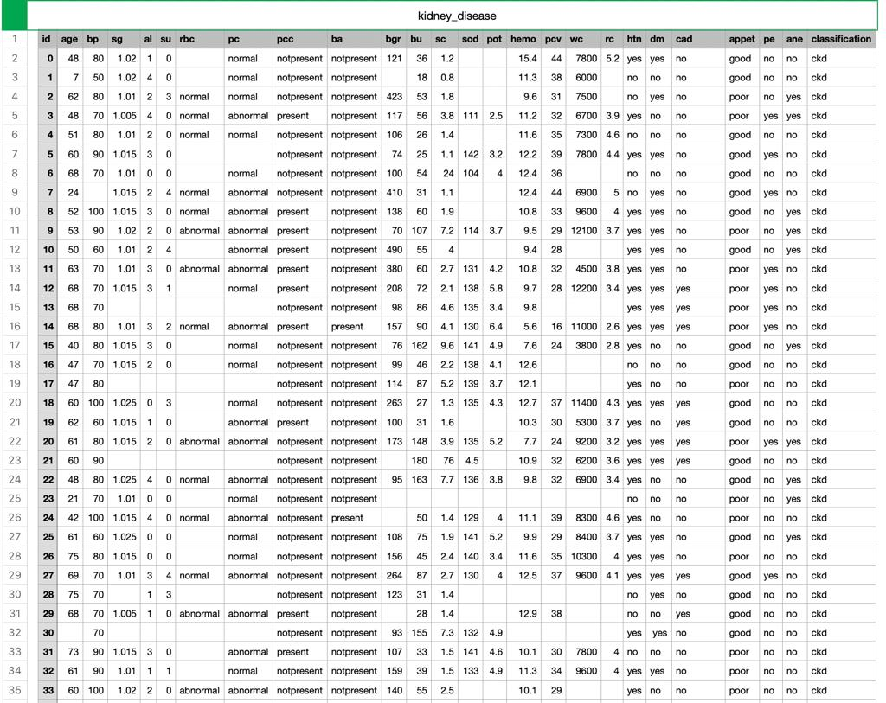
Implementation
Dataset

Slide 23
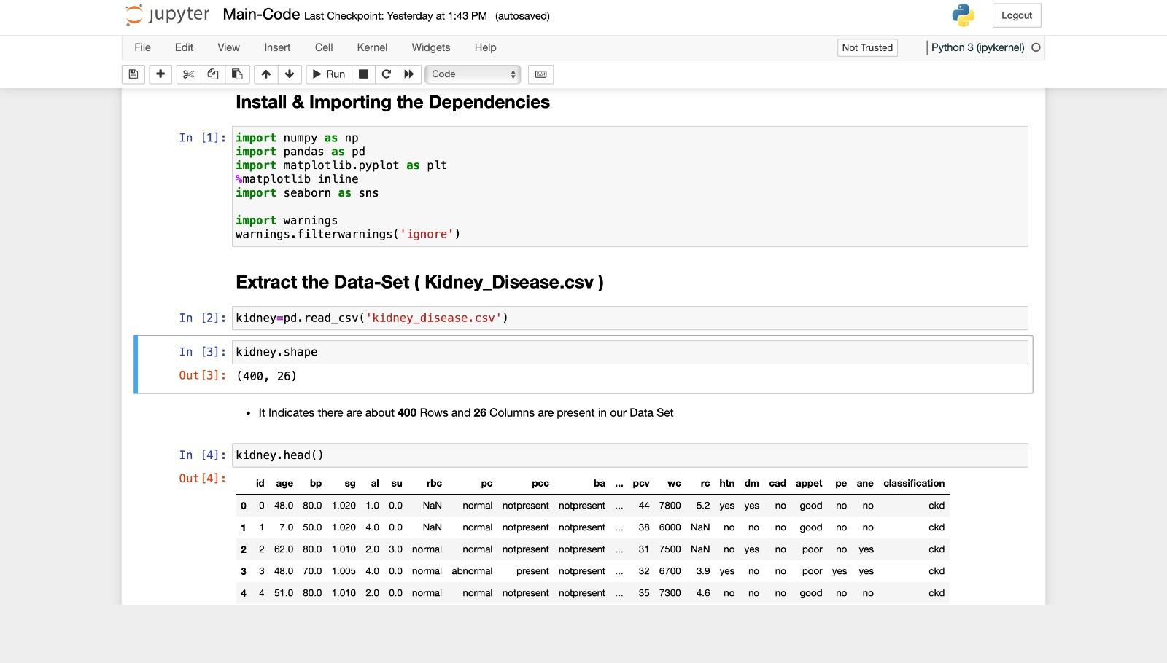
Implementation

Slide 24
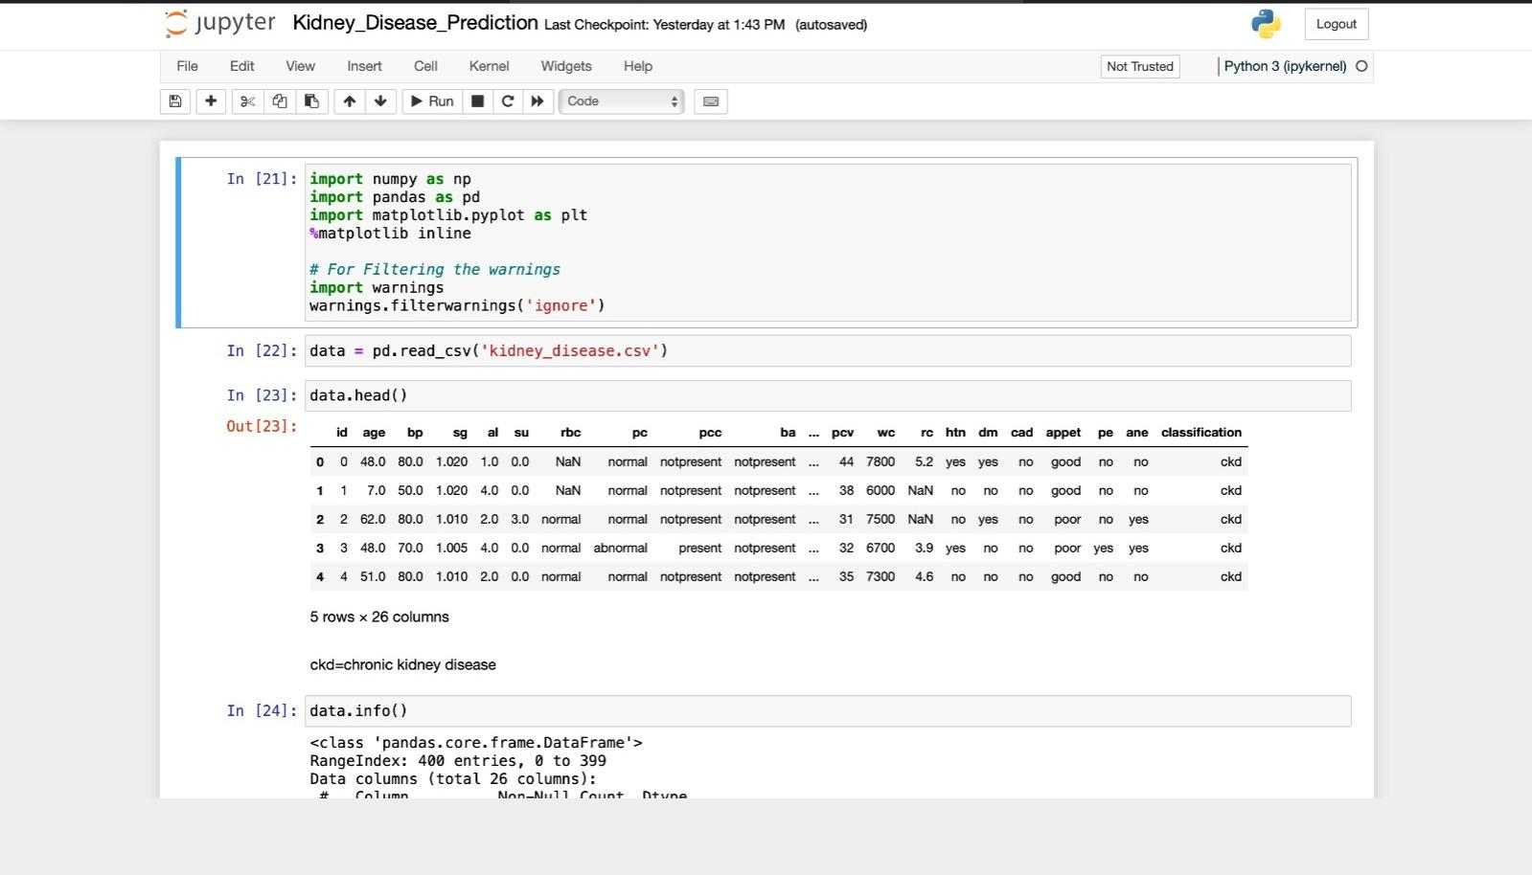

Slide 25
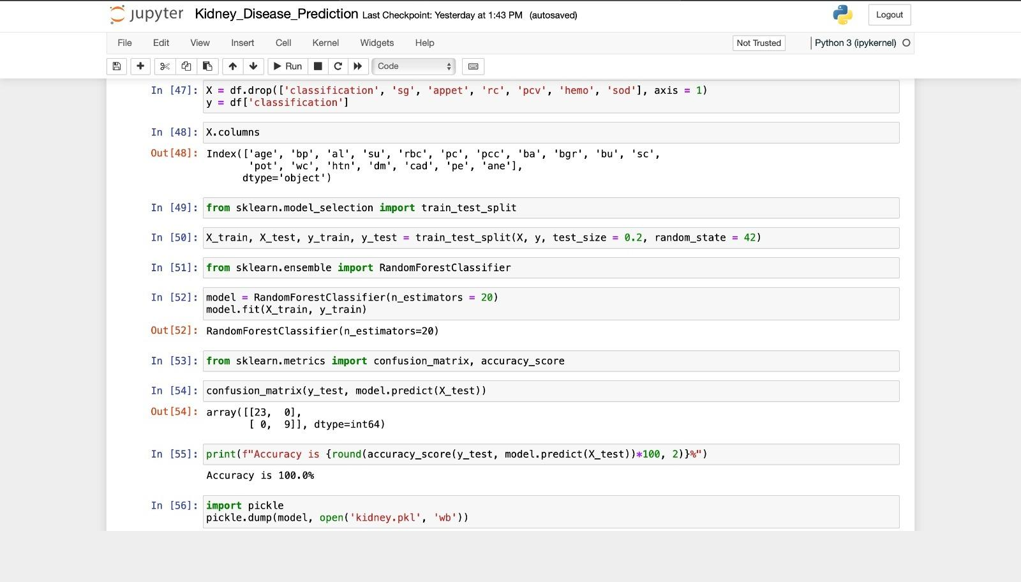

Slide 26
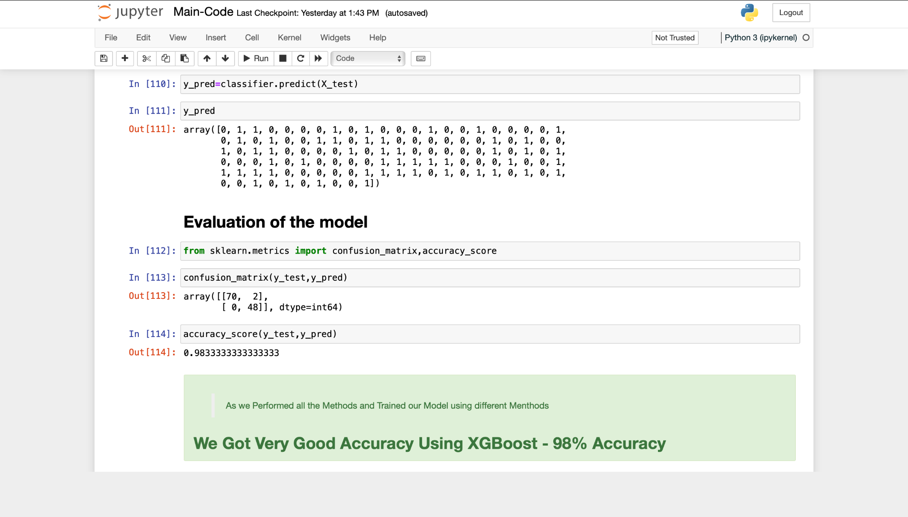

Slide 27
Results and Discussion
Model Performance: Assess the performance of kidney disease prediction models in terms of accuracy, sensitivity, specificity, and AUC-ROC. Identify the models that excel in predicting kidney disease based on the dataset.
Feature Importance: Analyze the significance of different features in predicting kidney disease. Discuss which clinical or laboratory variables are most influential in the predictions.
Handling Imbalanced Data: If the dataset is imbalanced (e.g., more non-disease cases than disease cases), discuss how the models handle this issue and whether techniques like oversampling, undersampling, or synthetic data generation were applied.
Interpretable vs. Complex Models: Compare the interpretability of simpler models like decision trees and logistic regression with complex models like deep learning. Discuss the implications of model interpretability in clinical practice.

Slide 28
Results and Discussion
Data Preprocessing: Describe any data preprocessing steps, such as data cleaning, normalization, or feature engineering, that were performed to enhance model performance.
Clinical Implementation: Discuss the feasibility of implementing the predictive models in a clinical setting. Consider factors like user-friendliness, integration with electronic health records, and healthcare provider acceptance.
Limitations: Address the limitations of the models, such as their generalizability across diverse patient populations or potential challenges in handling missing data.
Future Directions: Propose potential improvements or future research directions, such as exploring additional data sources (e.g., genetic data) or applying advanced techniques like federated learning for privacy-preserving predictions.

Slide 29
Future Enhancements
Multimodal Data Integration: Incorporate additional data sources such as genetic information, wearable device data, and lifestyle factors to enhance prediction accuracy.
Continuous Monitoring: Expand real-time monitoring capabilities, allowing for a more comprehensive view of patient health and enabling early intervention in response to critical changes.
Explainable AI: Enhance model interpretability to provide clearer insights into the factors driving predictions and ensure trust among healthcare providers and patients.
Integration with Electronic Health Records (EHR): Seamlessly integrate predictive models with EHR systems to streamline clinical workflows and improve the efficiency of healthcare delivery.
Global Outreach: Extend the application of kidney disease prediction to underserved and remote regions by incorporating telehealth and remote monitoring technologies.
Patient-Centric Care: Focus on empowering patients with tools to actively manage their health by providing personalized recommendations and education.

Slide 30
Future Enhancements
Collaborative Research: Collaborate with researchers to contribute to the scientific understanding of kidney diseases and advance the field.
Regulatory Compliance: Stay updated with evolving healthcare regulations and ensure that the project aligns with privacy and data security standards.
Predictive Modeling Advancements: Explore cutting-edge machine learning algorithms, beyond Random Forest and XGBoost, to further improve predictive accuracy and model efficiency.
Real-World Validation: Conduct real-world studies to validate the impact of the predictive model on patient outcomes and healthcare system performance.

Slide 31
References
https://ieeexplore.ieee.org/document/10061025 - Chronic Kidney Disease Prediction using Data Pre-Processing Techniques Publisher: IEEE Authors- O. Aruna; Sk Sameerunnisa.
https://ieeexplore.ieee.org/document/10170671
https://www.ahajournals.org/doi/abs/10.1161/CIRCRESAHA.122.321762
https://www.tandfonline.com/doi/full/10.1080/14737167.2023.2237679
https://www.sciencedirect.com/science/article/abs/pii/S1051227622002126

Slide 32
Questions?

